Slide 1
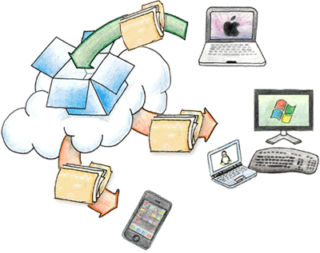
Creating and Sharing Digital Media
The Elaborative Learning Environment

Slide 2
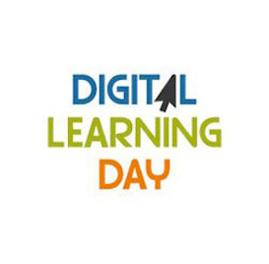
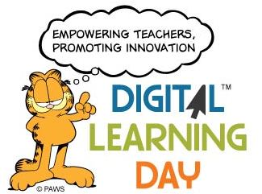
Help Celebrate Digital Learning Day
Select Link For Resources
February 1, 2012

Slide 3
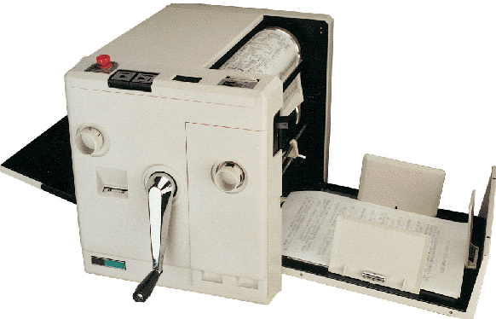
My First Printer
Crank Technology

Slide 4
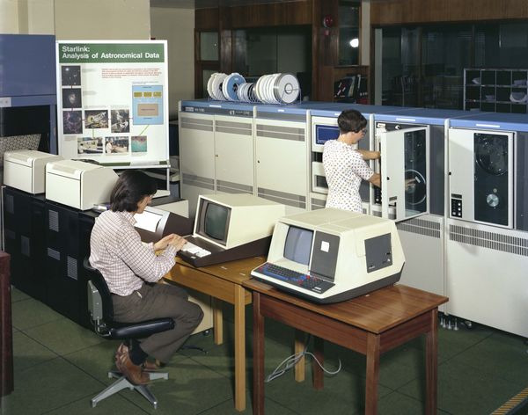
My First Research Paper
Mainframe Technology

Slide 5
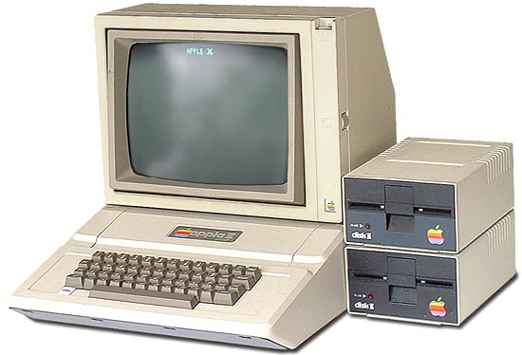
My First Computer
Apple II

Slide 6
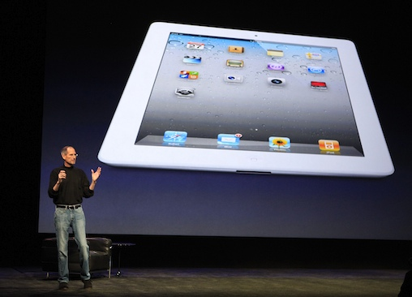
What I Teach with Today
iPad II

Slide 7
New Mediums of Expression
Web 2.0 is a new set of tools that allows users to collaborate ideas through new mediums of expression.

Slide 8
Mashing Content
These mediums of Web 2.0 expressions allow non-web designers to create, remix, and mash together their own content online.

Slide 9
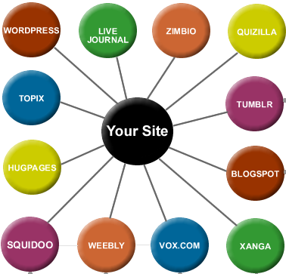
Content Creation Tools
Web 2.0 content creation tools occurs through the design of multi-user interfaces such as wiki’s, podcasting, vodcasting, eBooks and blogs.

Slide 10
Enter Mash up Tool Number One
dotEPUB is software in the cloud that allows you to convert any webpage into an e-book.

Slide 11
Copy and paste this code into a new bookmark ↓
javascript:(function(){var%20d=document;try{if(!d.body||d.body.innerHTML=='')throw(0);var%20dotEPUBcss=d.createElement('link');dotEPUBcss.rel='stylesheet';dotEPUBcss.href='http://dotepub.com/s/dotEPUB-favlet.css';dotEPUBcss.type='text/css';dotEPUBcss.media='screen';d.getElementsByTagName('head')[0].appendChild(dotEPUBcss);dotEPUBstatus=d.createElement('div');dotEPUBstatus.setAttribute('id','dotepub');dotEPUBstatus.innerHTML='<div%20id="status"><p>working...</p></div>';d.body.appendChild(dotEPUBstatus);var%20dotEPUB=d.createElement('script');dotEPUB.type='text/javascript';dotEPUB.charset='utf-8';dotEPUB.src='http://dotepub.com/j/dotepub.js?x='+(Math.random());dotEPUB_links=0;dotEPUB_format='epub';dotEPUB_lang='en';d.getElementsByTagName('head')[0].appendChild(dotEPUB);}catch(e){alert('The%20page%20has%20no%20content%20or%20it%20is%20not%20fully%20loaded.%20Please,%20wait%20till%20the%20page%20is%20loaded.');}})();

Slide 12
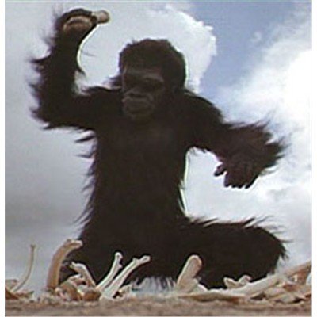
Dot ePub Demonstration

Slide 13
Affinity Spaces
We can call such informal learning cultures “affinity spaces,” asking why people learn more, participate more actively, engage more deeply with popular culture than they do with the contents of their textbooks.

Slide 14
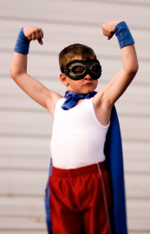
Creating Digital Content
So Why Not
Create our Own Books?
Bored with Reading
Then Read, Write and Share

Slide 15
Five Easy Steps to Book Creator
DEMONSTRATION
Create A PowerPoint
Convert PowerPoint to gif
E-Mail Converted Files
Open Converted Files in Photo Gallery
Start A New Book in Book Creator

Slide 16
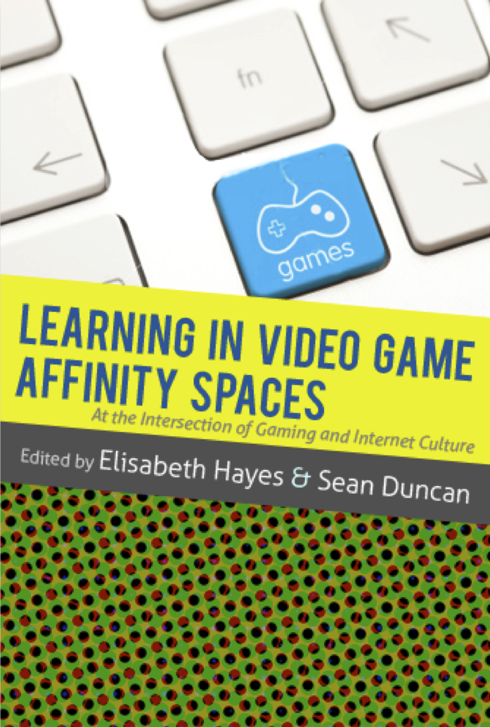
What is the ideal learning environment?
Many have argued that these new participatory cultures represent ideal learning environments.

Slide 17
Campfires in Cyberspace
Primordial Metaphors
Learning
Spaces

Slide 18
SHARING
Campfire situations are characterized by communication flowing from one to many, requiring a space that can accommodate a certain number of people in a group situation, where everybody can focus on the person talking or presenting.

Slide 19
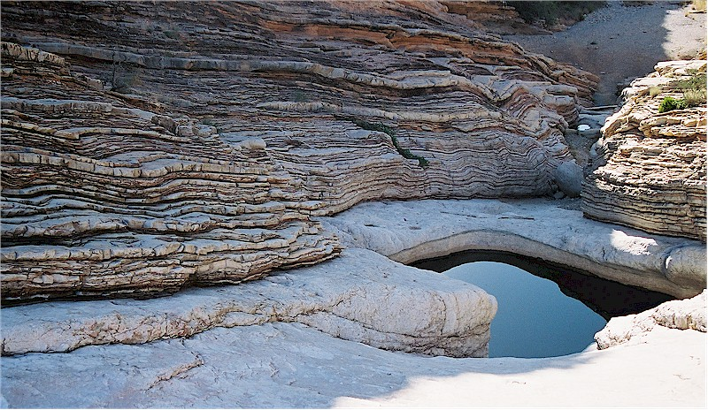
Remembering
The watering hole is a place where people come and go, and a learning environment where you can gather in groups of different sizes. A watering hole is a place of exchanging communication, flowing back and forth. The watering hole areas are typically placed where you naturally would go, and where you maybe bump into somebody or something.

Slide 20
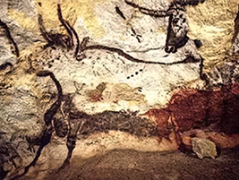
understanding
Show-off situations are situations where one person communicates towards the rest of the world, showing what he or she can do or has done, thus requiring a physical space for display and exhibition.
In the cave, communication flows within oneself, requiring a physical frame that furthers seclusion and contemplation.

Slide 21
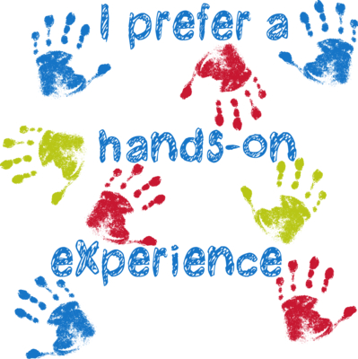
Applying
Lastly, the laboratories are places where the students can acquire hands-on experiences, working physically and practically with projects in a societal and experimental context. The laboratories inspire students and teachers alike, enlarging the learning experience and inspiring teachers to use different tactile approaches.

Slide 22
Conservative vs. Experimental “linked to ontological content”
"While formal education is often conservative, the informal learning within popular culture is often experimental." Gee (2004)

Slide 23
Let’s Purge Some Content
This free online file converter lets you convert media easy and fast from one format to another.

Slide 24
Demonstration

Slide 25
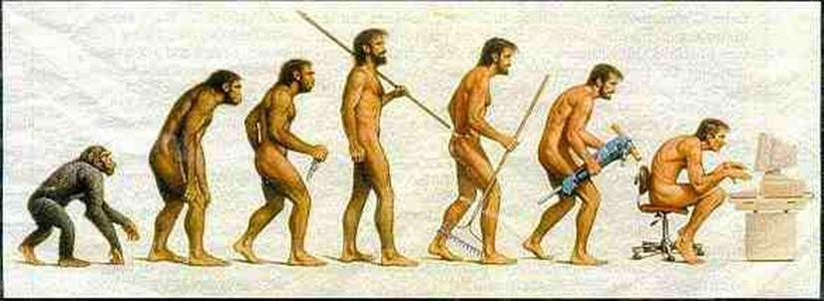
Digital Mash ups in a Divergent World

Slide 27
Traditional Learning
Traditionally learning has been connected by the context when students are learning on their own and by applying new knowledge as they expand a deeper understanding through repetition.

Slide 28
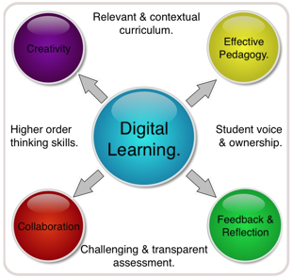
Connected Learning
The research supports the idea that connected learning should be approached not as an afterthought to the school day, but as a focused strategy for increasing understanding.

Slide 29
Conceptual Learning
It should be noted that both reinforcement of learning through practice and repetition is viable to procedural memory but may not support semantic, declarative or implicit memory when consolidation of ideas are needed in making conceptual ties.

Slide 30
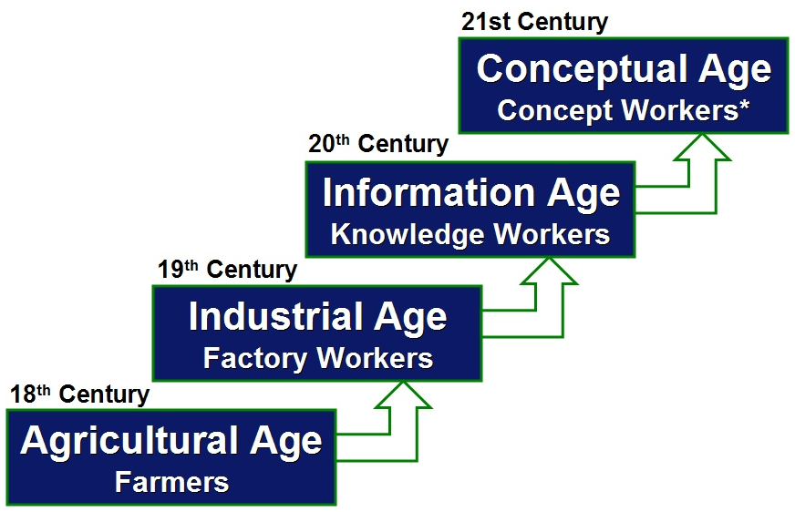
Associations between Knowledge and Application
To better assist learning, associations must be made between knowledge and application while the facilitator of content must provided a truer form of elaborative rehearsal within the learning environment

Slide 31
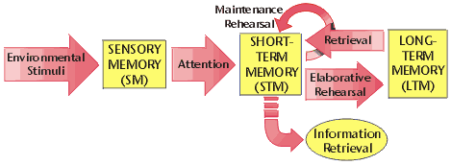
Intricate Learning, Individualizes Complexity and Rigor
Elaborative rehearsal encompasses a variety of digital mash up strategies that provides the learner an opportunity to intricate their own learning.

Slide 32
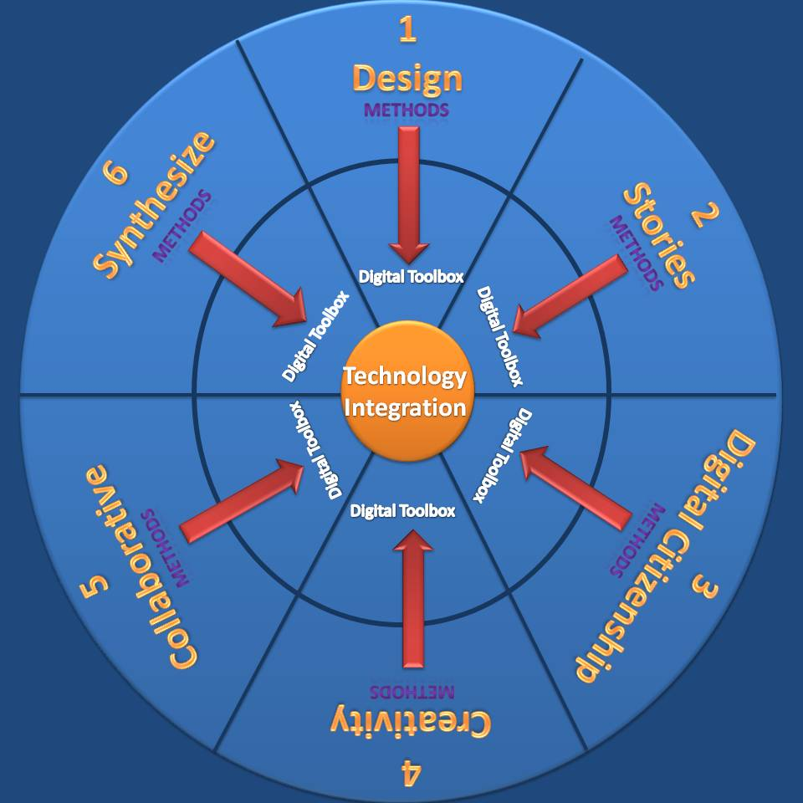
Elaborative Learning Model
Through elaboration the learner can express ideas more openly using multiple skill sets to compare new concepts with known concepts that hooks the unfamiliar with something familiar.

Slide 33
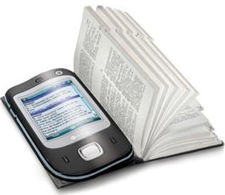
We Need A Purpose
Before we get started we will need a purpose for why we would want to create and publish digital content?
Education is changing
Mobile learning becomes interactive

Slide 34
Storage & Content Sharing
Digital Content Shared Across Networks

Slide 35
Creating Shared Storage
1. Create A Dropbox Account
2. Create A box Account

Slide 36
Why eBooks over pdf?

Slide 37
iPad: Guided Reading
Guided reading is a strategy that helps students become good readers. It is a strategy that supports students to discover the meaning of a text for themselves.

Slide 38
Why eBooks are Fluid
Highlight words/ sentences-
Make Notes on page
Look-up words in the dictionary
Search for the word on the Internet
Write and Create Your Own eBooks
Create, Store & Share eBooks
Make Books Interactive/Audio/Video
Create & Organize You Library

Slide 39
Demonstration

Slide 40
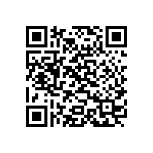
QR Codes
A QR Code is a two dimensional bar code which when scanned using your camera phone enables you to access some pre-written content or complete a task.

Slide 41
How Can You Create a Shared Environment with QR Codes
A QR could be a facilitator to reading some text, accessing a web site or sending a text message or an email.

Slide 42
Using the QR Code Generator

Slide 43
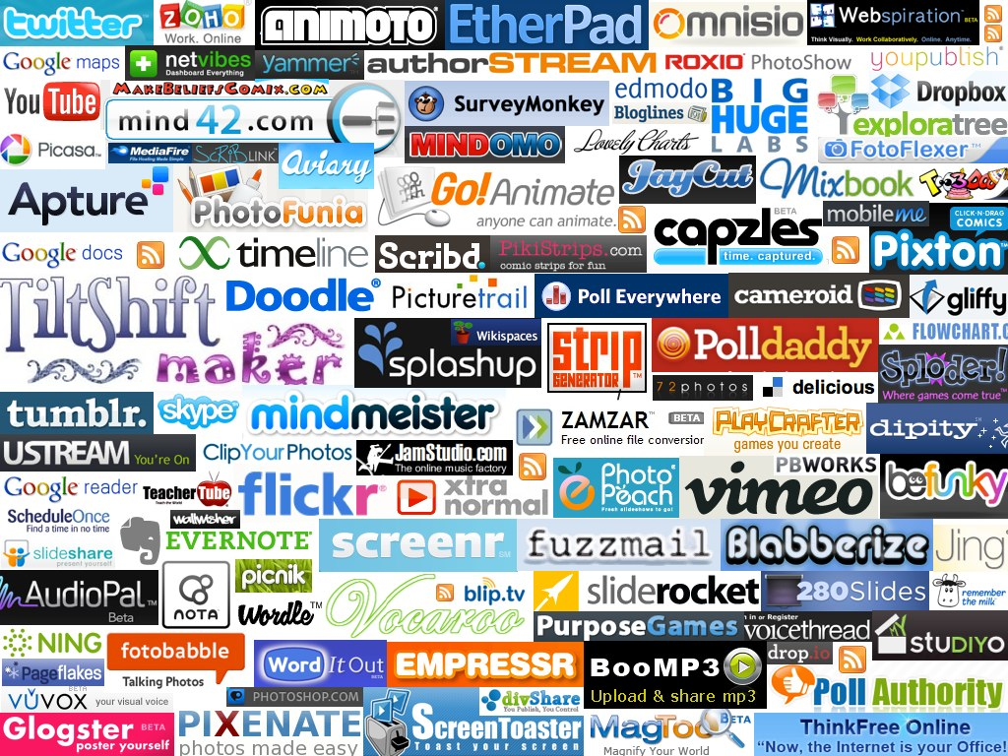
Sharing Digital Content with Web 2.0 Tools

Slide 44
Learn how to build Google Sites
Create Classroom Sites
use guides to learn how to create docs and sites for your classes
and Google Docs for your classroom.

Slide 45
Serves as an Assembly Dashboard for Bookmarking Frequently Used Web2.0 Tools
Symbaloo’ is a Greek Verb Meaning Assembling
Notes:
Symbaloo’ is a Greek verb that stands for ‘assembling’ and serves an assembly dashboard for bookmarking frequently used Web2.0 tools.

Slide 46
“as a carpenter would keep their tools in a tool box”
Personalize Web 2.0 Tools
Notes:
Users can personalize their own set of Web 2.0 tools as a carpenter would keep their tools in a tool box.

Slide 47
Tabs can be Created
to Formulate Sub Categories
that can include frequently used sites for mixing content, storing content or generating content
Notes:
Additional tabs can be created to formulate sub categories for tools that can include frequently used sites for mixing content, storing content or generating content.

Slide 48
Can Serve as an Assignment Marker
for Created Content.
Notes:
In the education world Symbaloo not only serves as a book mark for frequently used Web 2.0 tools but can serve as an assignment marker for created content.

Slide 49
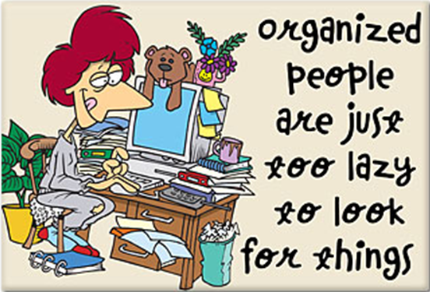
Serves As A Tool For
Helping Students Stay Organized
Notes:
Symbaloo can also serve as a tool for helping students to stay organized. Each time a student is taught how to use a new Web 2.0 resource a student can post an interactive link to their symbaloo navigation board. (See Symbaloo User Guide)

Slide 50
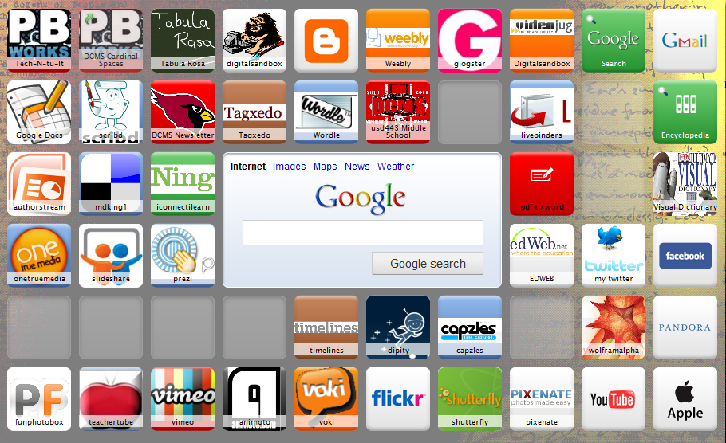
Digital Sandbox
Notes:
Symbaloo EDU (http://edu.symbaloo.com) Sharing the web with students can be a challenge. Websites can often have urls that feel unending, students can copy down a url incorrectly, students type with different speeds, or characters show up in the address that they are unfamiliar with. Complicated urls can single-handedly persuade the elementary teacher to ditch a wonderful web resource for something easier to manage...like a worksheet. Sharing websites with your students doesn’t have to be a challenge.

Slide 51
To ask questions about today's presentation go to

Slide 52
Setting up a Backchannel
A backchannel is a location for all the background comments, questions and noise that are not part of the lesson/presentation.
Notes:
Setting up a backchannel
A backchannel is a location for all the background comments, questions and noise that are not part of the lesson/presentation.

Slide 53
Corrective Feedback/Checking for Understanding
While working on an assignment have students ask all questions and comments on the todaysmeet page.
Answer questions and give help, hints, and ideas about the assignment on the todaysmeet page.
Notes:
#2 – Classroom Management
While working on an assignment have students ask all questions and comments on the todaysmeet page.
Answer questions and give help, hints, and ideas about the assignment on the todaysmeet page.

Slide 54
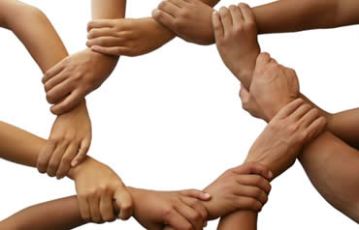
When you want your students to visit a specific webpage, but the address is too long. Post the address to the todaysmeet page for the students to click on.
Link
Sharing
Have students search the web for resources, then have them share the links to the best resources on the todaysmeet page.
When student’s complete a Web 2.0 project have them submit the address of their final project as their method for “handing it in.”
Notes:
#3 – Link sharing
When you want your students to visit a specific webpage, but the address is too long. Post the address to the todaysmeet page for the students to click on.
Have students search the web for resources, then have them share the links to the best resources on the todaysmeet page.
When student’s complete a Web 2.0 project have them submit the address of their final project as their method for “handing it in.”

Slide 55
Web-based File Sharing
Dropbox is a Web-based file hosting service that uses cloud storage. Dropbox provides 2 GB of free online storage.

Slide 56
Weblist lets you pull together and organize content on the web.
Create a list of urls centered on a theme and combine them into one easy to navigate url weblist. The list can be
saved as a bookmark or a homepage.
Notes:
Weblist (http://weblist.me) Weblist lets you pull together and organize content on the web. Create a list of urls centered on a theme and combine them into one easy to navigate url weblist. The list can be
saved as a bookmark or a homepage. Weblist is particularly useful for the primary elementary classroom because of its visual aspect. Each website is saved as a snapshot of that website with the website name and a description below. The visual organization is perfect for younger students who may not be able to navigate links designated by text alone.

Slide 57
Video Demonstrating Synchronization
The downloadable open source software application allows users to store and share files and folders with others across the Internet using file synchronization.

Slide 58
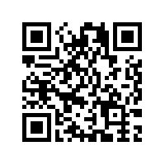
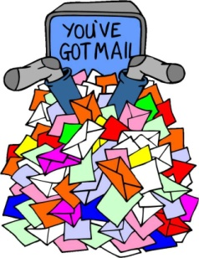
Box.net Grate for Audio Casting
Box.net features online storage services, including remote access through a web interface, access to files on mobile devices and file sharing capabilities. Box.net is ideal for sharing audio files of lessons or podcast.
Create
New Way
Store & Share
Old Way to Share
Post It
Stop

Slide 59
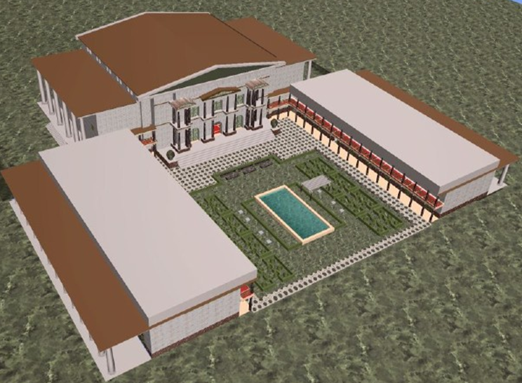
The ePub Generation
"The New Alexandrian Libraries of the Future"
" We are moving away from a world in which some produce and many consume media, toward one in which everyone has a more active stake in the culture that is produced."
Notes:
As first light shines on the 21st Century, Americans are once again experiencing a profound and rapid shift–from the Industrial Age to the Information Age and into the Conceptual Age. " We are moving away from a world in which some produce and many consume media, toward one in which everyone has a more active stake in the culture that is produced."
From the Internet’s inception its creators envisioned a universal substrate linking all mankind and its artifacts in a seamless, interconnected web of knowledge. This is the World Wide Web’s great promise: an Alexandrian library of all past and present information and a platform for collaboration to unite communities of all cultures in any conceivable act of creative enterprise. It is with these thoughts that education will experience what historians will call the Third Revolution, a transition to a knowledge-base of conceptual linking of the internet to co-collaborative read and write websites of the creation of the Alexandrian libraries of the future.

Slide 60
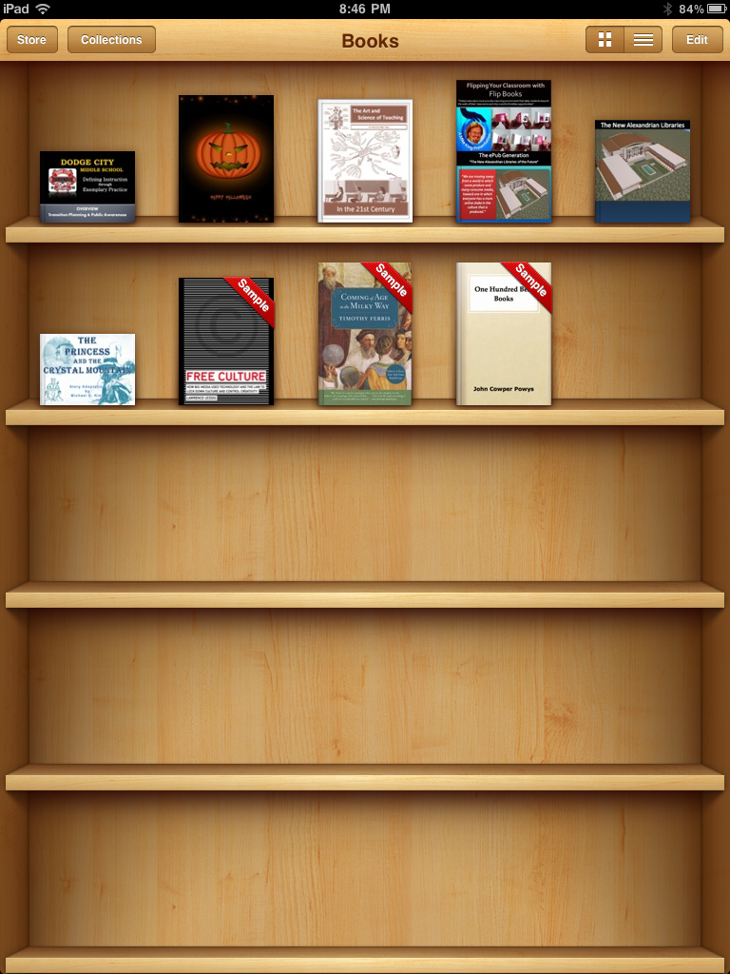
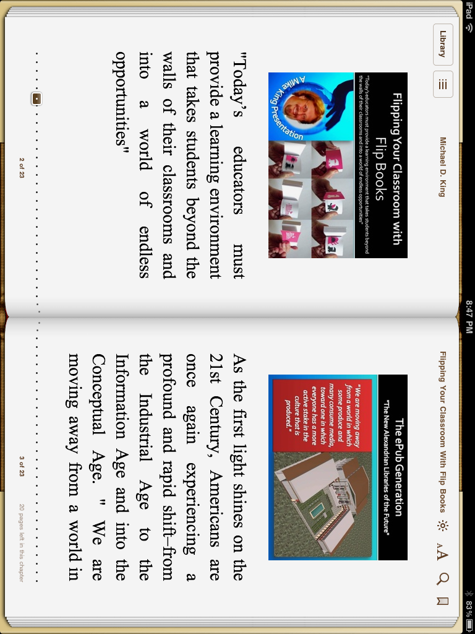
Today we are going to create an eBook.
My NEW E-Book
My e Book library

Slide 61
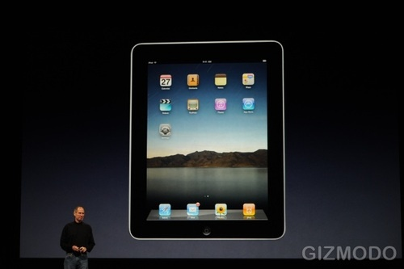
What You Will Need
To complete the task we will need some tools & applications

Slide 62
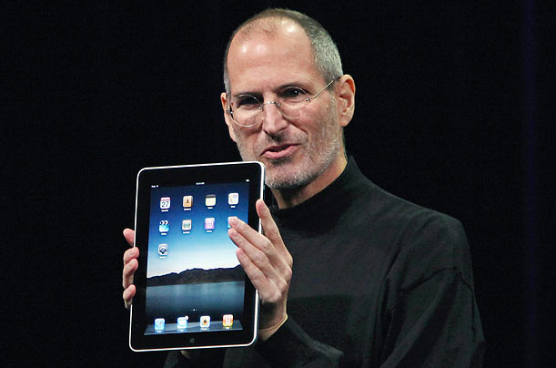
Tools = One iPad
I think I need an iPad 2

Slide 63
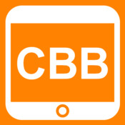
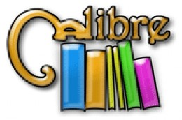
Applications = One From a Choice of Many
iPad Applications
On Line Applications

Slide 64
To create an eBook we will need some content
Text
Video
Audio
Illustrations
Images

Slide 65
Tricks & Tweaking in Creative Book Builder
When Using Media
Use YouTube downloader
Convert to medium low quality iPhone
Compress mp3 files to medium quality
Create illustrations in PowerPoint and convert to gif file

Slide 66
YouTube Downloader

Slide 67
Help Celebrate Digital Learning Day
Select Link For Resources
February 1, 2012

Slide 68
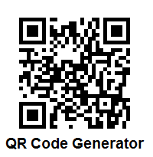
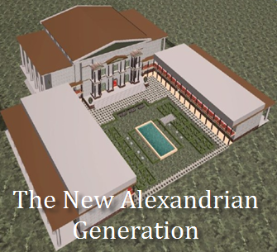
Resources to Creating and Sharing Digital Media

