Slide 1
Creative Book Builder
How to Create an eBook
Notes:
How to Create an eBook
To make a quality book that allows the reader to interact requires another type of application. A new iApp just recently released called Creative Book Builder provides a simple process for creating an interactive e book. The Create a eBook Application cost $3.99 and is available on iApp.

Slide 2
Creating & Publishing with Creative Book Builder
With creative book builder you can create interactive books that include
hyperlinks
Audio Recordings
Video
Podcast
Text
Illustrations
Notes:
Creative Book Builder enables everyone to create, edit and publish ebooks in a few minutes. All published e books can be read by any e Pub reader including iBooks. Everyone can become a publisher. Creative Book Builder can import document from Google Docs and parse HTML output into chapter. With creative book builder you can create an interactive books that includes;
hyperlinks
Audio recordings
Video
Podcast
Text
Illustrations

Slide 3
The Goggle Docs Quick Way
Notes:
The Easy Way to Make An Interactive e Book
The easiest way to create an interactive book with book builder is to use Google Docs. To be an interactive book two functions must be applied. The first function is content and the second function would be that some media within the text must act independently within the content. With creative book builder you can simply access your Google Docs account through the user interface. To make the book interactive you would include additional resources as references in the end sections of the book. End sessions are chapters, or chunks of content that are layered in sequence within the book builder interface. This process can be applied in the following illustrations;

Slide 4
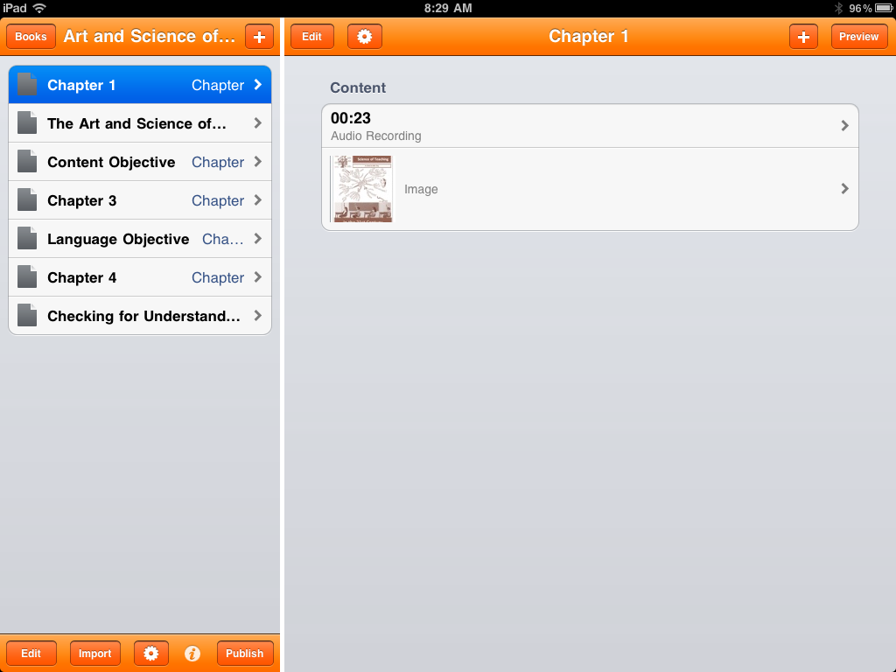
To demonstrate how to creative an e-book in Creative Book Builder, planed content must be available and ready to import.
Start the create a book application and select Books. Selecting the books menu button will allow a title to be entered in the next step.
Select Books
Notes:
To demonstrate how to creative an e-book in Creative Book Builder, a document file will need to exist on the Google Docs application site. Start the Create Book Builder application and select Books. Selecting the books menu button will allow a title to be entered in the next step.

Slide 5
Select the Plus Button and the next menu frame will appear for entering the title of your book.
Notes:
Select the Plus Button and the next menu frame will appear for entering the title of your book.

Slide 6
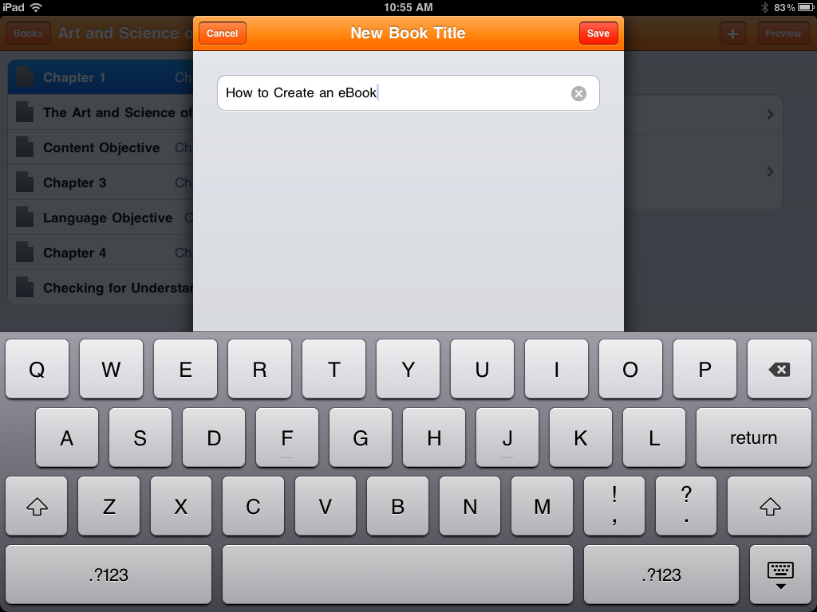
Type Title Name
Type the Title of the Book into the space provided. The title of the book to be created from the import process is named “How to Create an eBook.”
Select Save and the books title will appear in the Book list menu. Once this has been completed the next step will be to import a file.
Select Save
Notes:
Type the Title of the Book into the space provided. The title of the book to be created from the import process is named How to Create an eBook. Select save and the books title will appear in the Book list menu. Once this has been completed the next step will be to import a file.

Slide 7
Select Book Title
The next step is to select the book title .
Selecting the book title will allow for additional content to be added through the “Add Element” menu or “Import” document function.
Notes:
The next step is to select the book title . Selecting the book title will allow for additional content to be added through the “Add Element” menu or importing document function.

Slide 8
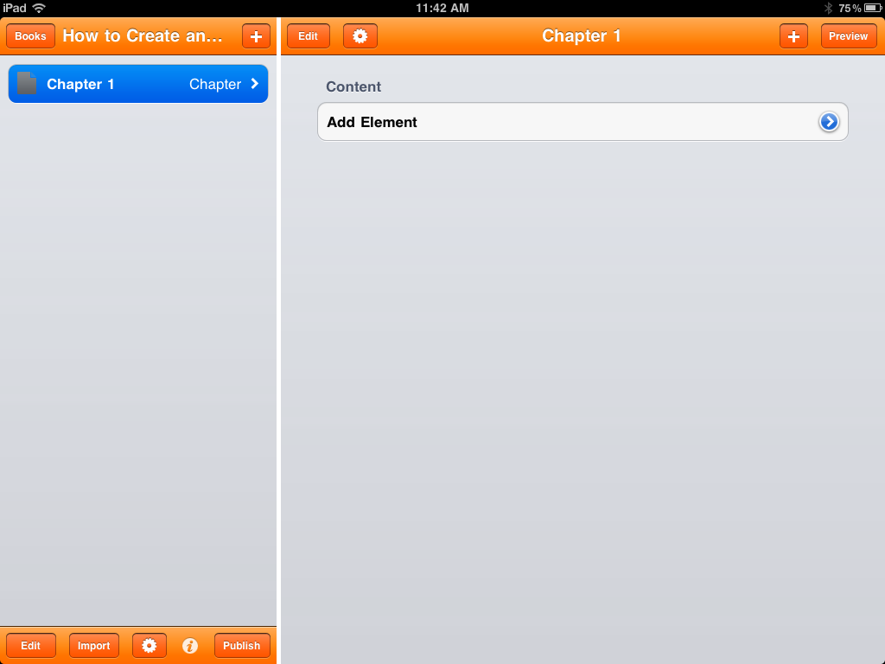
To import a document a document a file will need to exist on the Google Docs application site. It is important that files imported are to be selected in chunks. Plan content by eliminating bullets and numbers within the Google Document files. These “bulleted and numbered text” items are best imported through the “Add Element” function. To import, a document from Google Docs select Import.
Select Import
Notes:
To import a document a document a file will need to exist on the Google Docs application site. It is important that files imported are to be selected in chunks. Plan content by eliminating bullets and numbers within the Google Document files. These “bulleted and numbered text” items are best imported through the “Add Element” function. To import, a document from Google Docs select Import.

Slide 9
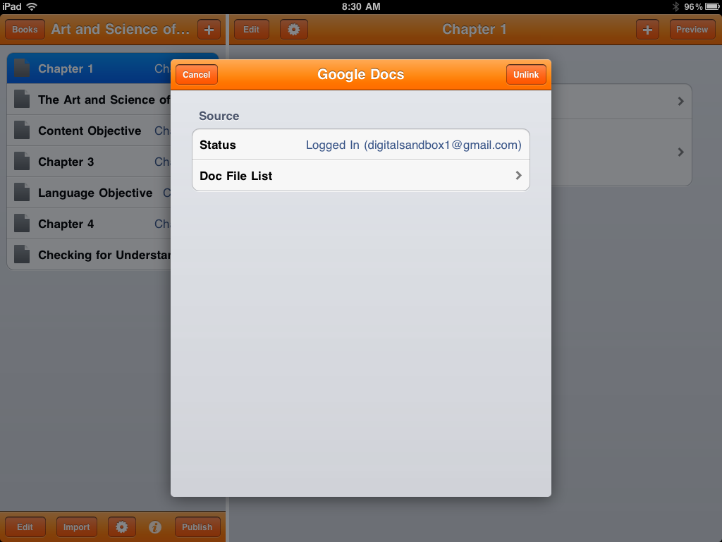
Select Doc File List
Then select from the menu as it recognizes that the status shows the user is logged into Google docs. Select “Doc File List” to see Google Docs menu.
Notes:
Then select from the menu as it recognizes that the status shows the user is logged into Google docs. Select Doc File List to see Google Docs menu.

Slide 10
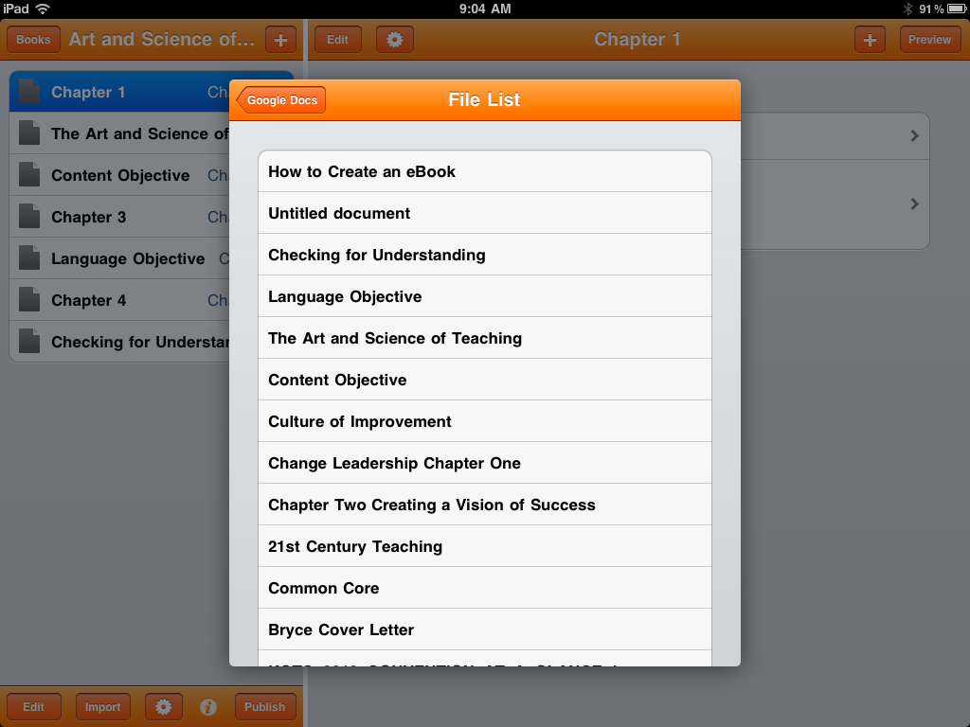
Select the document from the Google Doc files to import. In this case, “How to Create an eBook” will be selected.
Notes:
Select the document from the Google Doc files to import. In this case, “How to Create an eBook” will be selected.

Slide 11
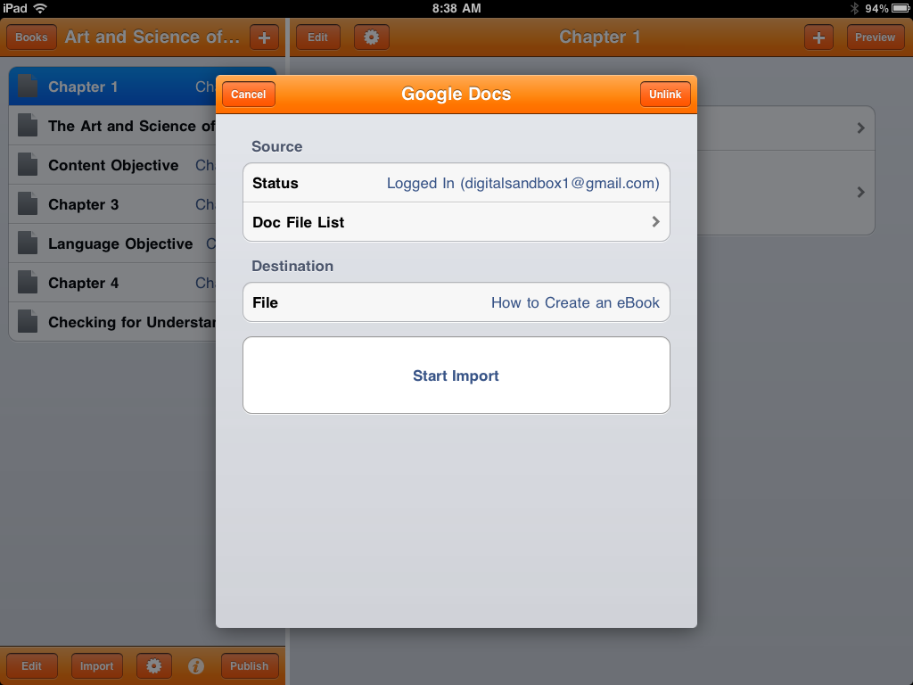
Check File
Check to make sure the file selected is what you want to import in the file menu box. The next step is to import the document from Google docs into creative book builder by selecting Start Import.
Select Start Import
Notes:
Check to make sure the file selected is what you want to import in the file menu box. The next step is to import the document from Google docs into creative book builder by selecting Start Import.

Slide 12
The last step is to save the imported Google Doc into Creative Book Builder
Notes:
The last step is to save the imported Google Doc into Creative Book Builder and begin working with the “Add Element” function.

Slide 13
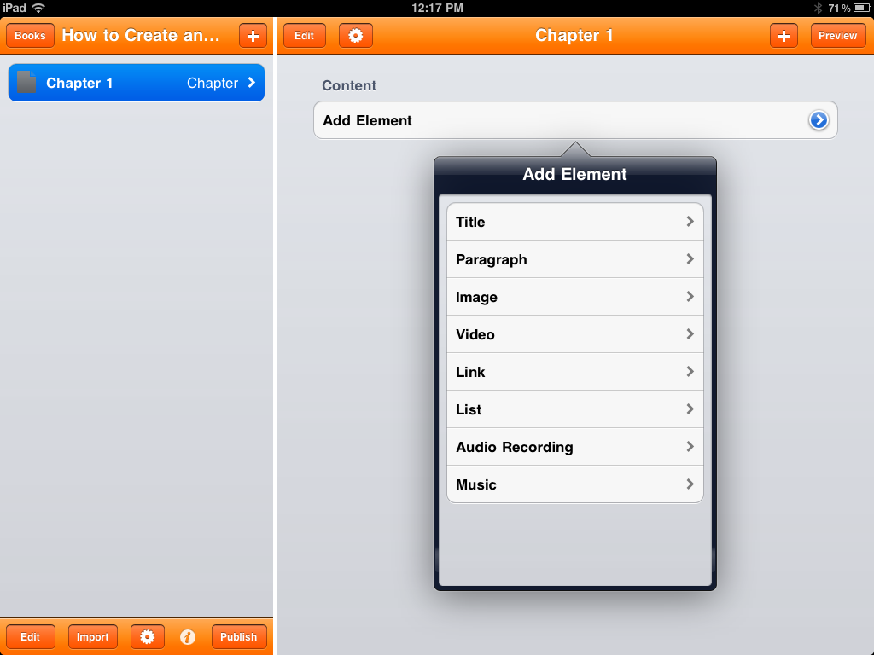
In the next few steps additional content will be added using the” Add Element” function. The “Add Element” function allows for text, video, audio and
images to be added to the eBook. Pre recorded video and audio sources are added through the use of iTunes. Images are added by using iPhoto and from iPad.
Notes:
In the next few steps additional content can be added using the” Add Element” function. The “Add Element” function allows for additional text, video, audio and
Illustrations to be added to the eBook. Pre recorded video and audio sources are added through the use of iTunes. Images are added by using iPhoto and from iPad. The “Add Element” function also allows for live audio recordings. The live audio recording is a great feature when used in education, for it allows for text recognition when reading the book in audio mode.

Slide 14
In the next few steps additional content will be added using the” Add Element” function. The “Add Element” function allows for text, video, audio and
images to be added to the eBook. Pre recorded video and audio sources are added through the use of iTunes. Images are added by using iPhoto and from iPad.
Notes:
Using the “Add Element” function allows for inserting an image or illustration. To add an illustration select the image function.

Slide 15
Publishing to iBooks
Notes:
Once the content of the eBook has been previewed and edited you will need a eBook reader. The recommended reader for iPad is iBooks, although other readers can be explored. The iPad is an ideal eBook reader for those who prefer reading on a backlit, larger screen. iBooks also connects to various web browser sources and can be linked to sites where eBooks are stored. If you are a teacher and you want to begin publishing material for the classroom, a recommended method to store classroom eBooks would be a wiki. A wiki will allow students to access the site via mobile learning device by hyperlinks or Q R codes.

Slide 16
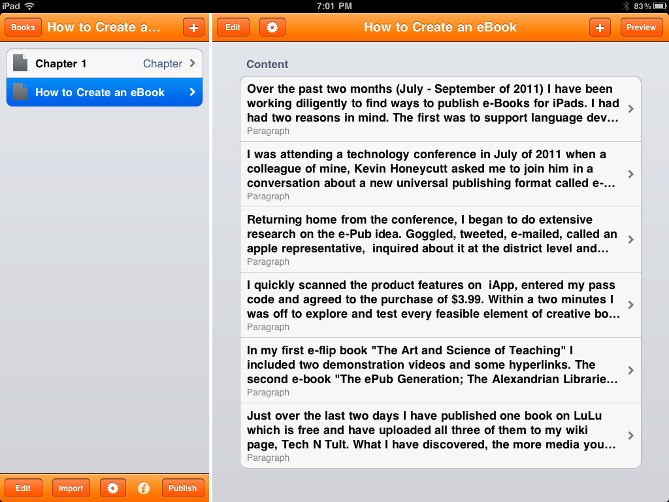
To publish the eBook select “Publish.” A popup menu will appear. It is recommended that the “Publish” function be used prior to closing out of the program. This will eliminate any possible loss of work developed during a work session.
Select Publish
Notes:
To publish the eBook select “Publish.” A popup menu will appear. It is recommended that the “Publish” function be used prior to closing out of the program. This will eliminate any possible loss of work developed during a work session.

Slide 17
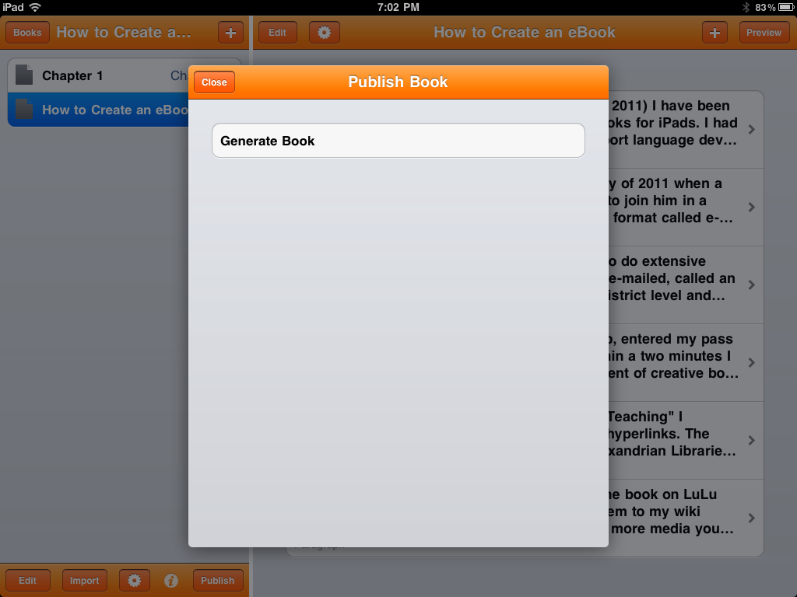
Select Generate Book
If the book is being published for the first time an option will be given to “Generate Book.” Select the “Generate Book” function. A second popup window will appear.
Notes:
If the book is being published for the first time an option will be given to “Generate Book.” Select the “Generate Book” function. A second popup window will appear.

Slide 18
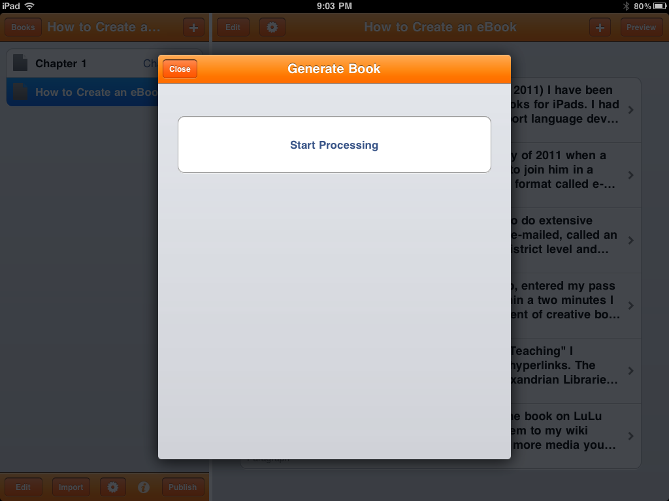
Select Start Processing
Select “Start Processing” in the Generate Book function box. This function will render the content into a ePub format.
Notes:
Select “Start Processing” in the Generate Book function box. This function will render the content into a ePub format.

Slide 19
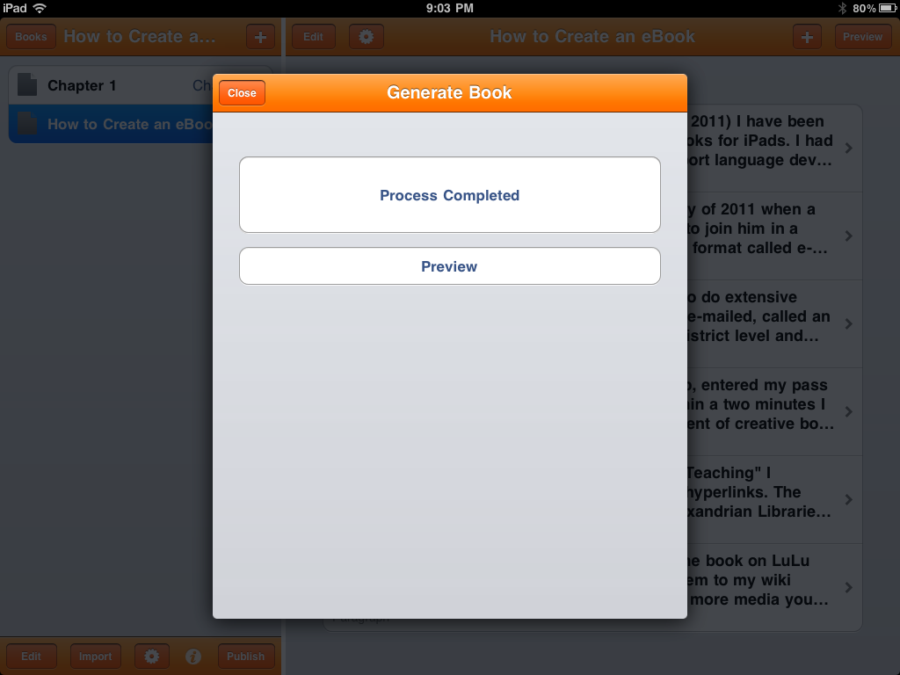
Select Preview
When the rendering process is completed the Preview function prompt will appear. The preview function allows for storage and read options. To view storage or read options select “Preview.”
Notes:
When the rendering process is completed the Preview function prompt will appear. The preview function allows for storage and read options. To view storage or read options select “Preview.”

Slide 20
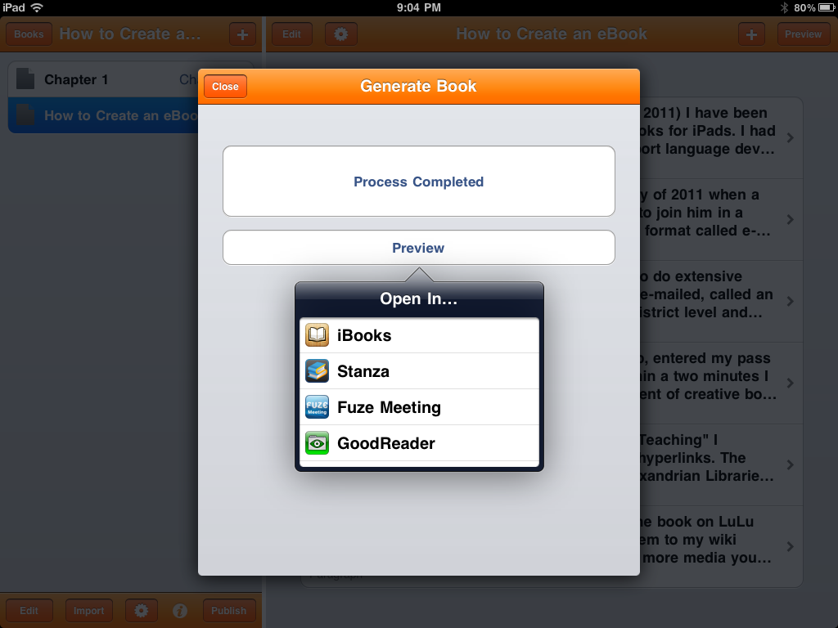
Select iBooks
The preview “Open In” menu will recognize what readers that are currently available on the iPod device. Select the iBooks option for the eBook to be stored iBooks.
Notes:
The preview “Open In” menu will recognize what readers that are currently available on the iPod device. Select the iBooks option for the eBook to be stored iBooks.

Slide 21
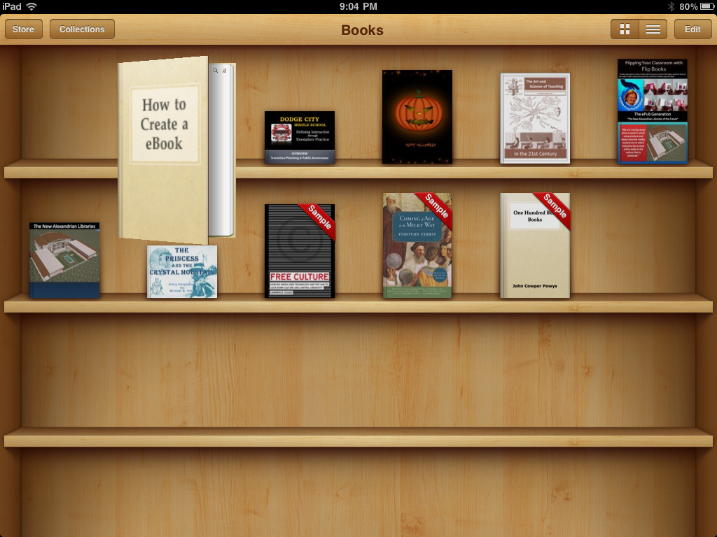
New eBook
If a book is already open in the iBooks Shelf it will appear as the first last eBook left open. The reader may take a few seconds to open.
Notes:
If a book is already open in the iBooks Shelf it will appear as the first last eBook left open. The reader may take a few seconds to open.

Slide 22
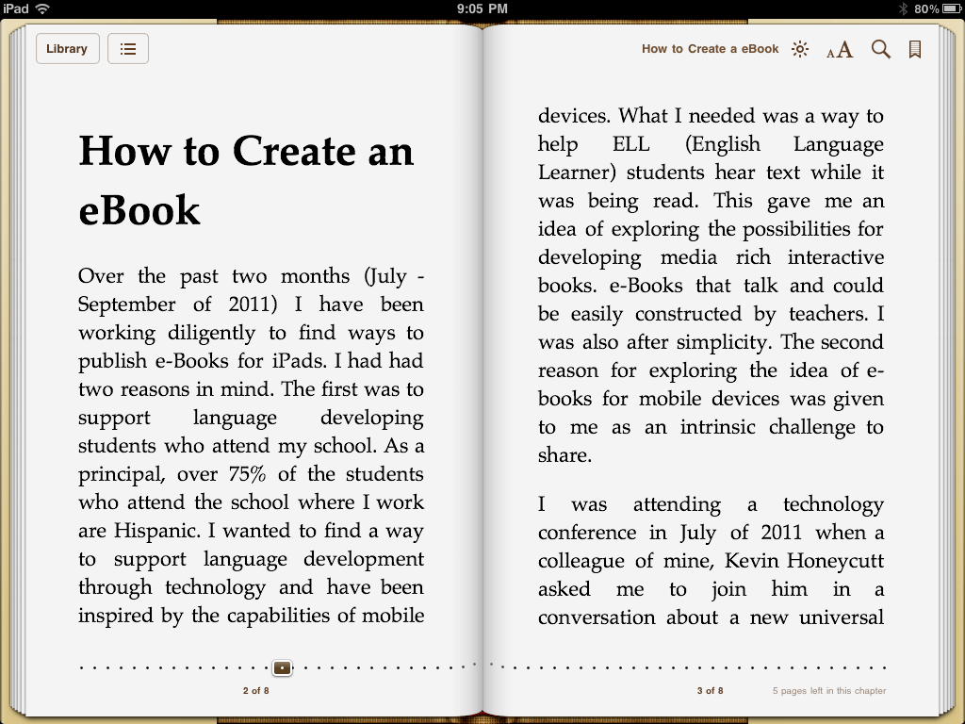
Select Library
The new eBook will open in read mode automatically. After previewing the new eBook select Library to close the book into shelf mode.
Notes:
The new eBook will open in read mode automatically. After previewing the new eBook select Library to close the book into shelf mode.

Slide 23
Storing in Dropbox
Notes:
Dropbox is a Web-based file hosting service that uses cloud storage. The downloadable open source software application allows users to store and share files and folders with others across the Internet using file synchronization. Dropbox provides 2 GB of free online storage. Dropbox is a useful storage device in the eBook environment because it allows the creator to temporarily store the eBook creation before the eBook is posted online. In this portion of the tutorial storage and upload options for newly created eBooks will be explored. Please note that in order for the Dropbox function to work the application must be installed on the iPad. (See App Store for Free Download) http://itunes.apple.com/us/app/dropbox/id327630330?mt=8#

Slide 24
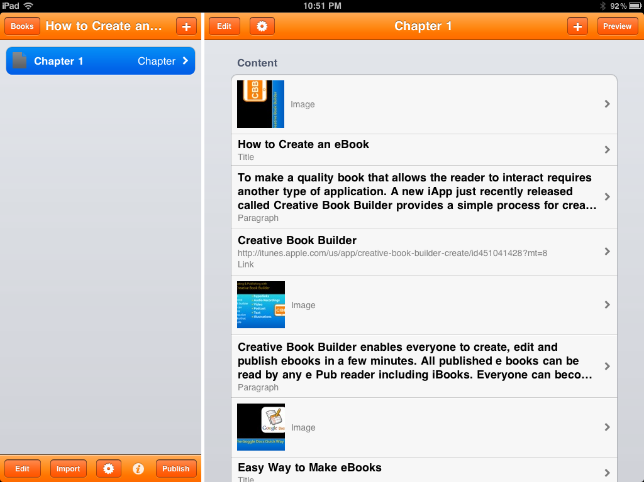
The next few steps will demonstrate how to retrieve the eBook and store it into temporary storage application such as Dropbox. These steps are designed to recover the ePub file onto a desktop so it can be uploaded to a school assignment website. On the dashboard select the Publish function to launch publishing options.
Select Publish
Notes:
The next few steps will demonstrate how to retrieve the eBook and store it into temporary storage application such as Dropbox. These steps are designed to recover the ePub file onto a desktop so it can be uploaded to a school assignment website. On the dashboard select the Publish function to launch publishing options.

Slide 25
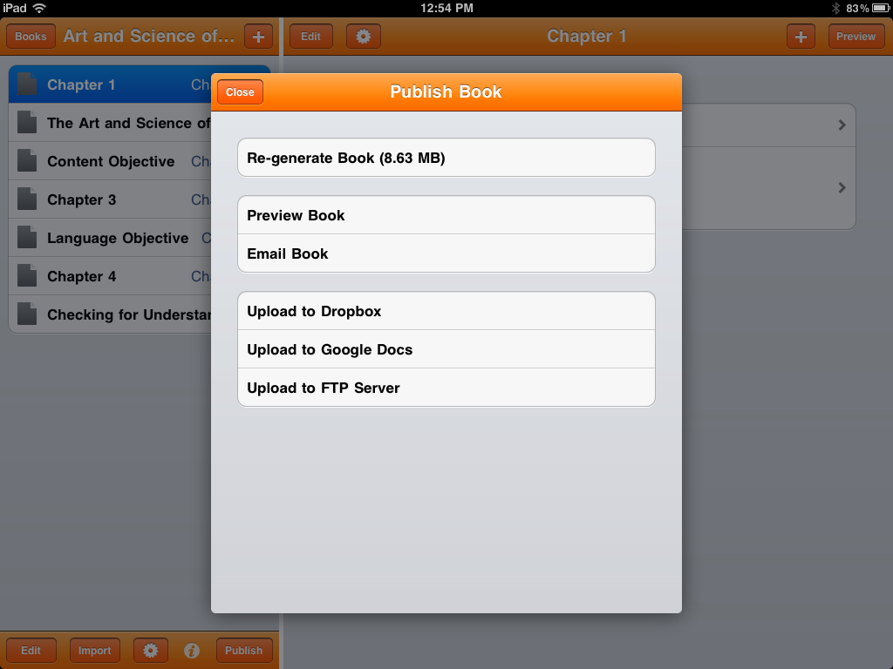
Select Upload to Dropbox
To upload to “Dropbox” select the “Upload to Dropbox” function. A new popup menu will appear to ensure that the user is properly linked to the “Dropbox” assignment folder.
Notes:
To upload to “Dropbox” select the “Upload to Dropbox” function. A new popup menu will appear to ensure that the user is properly linked to the “Dropbox” assignment folder.

Slide 26
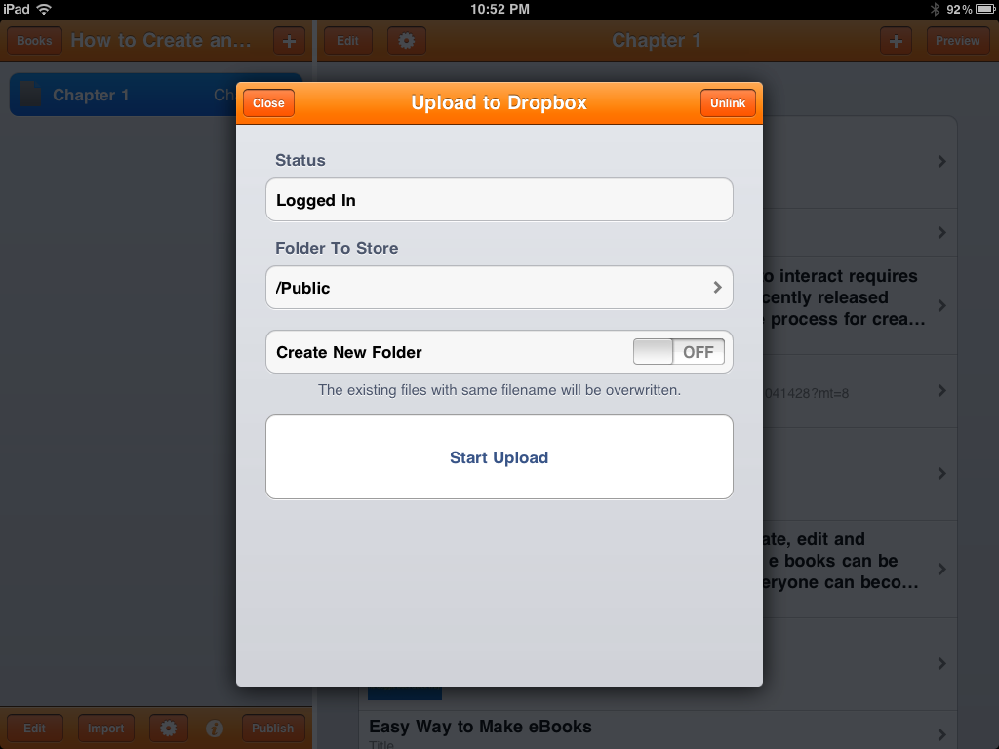
In the displayed popup menu a prompt provides a view of the upload options. In the upper right side of the menu provides information on accessibility showing the login status.
Select Start Upload
To start the upload to Dropbox select the “Start Upload” function. The upload may take a few minutes depending on the file size.
Notes:
In the displayed popup menu a prompt provides a view of the upload options. In the upper right side of the menu provides information on accessibility showing the login status. To start the upload to Dropbox select the “Start Upload” function. The upload may take a few minutes depending on the file size.

Slide 27
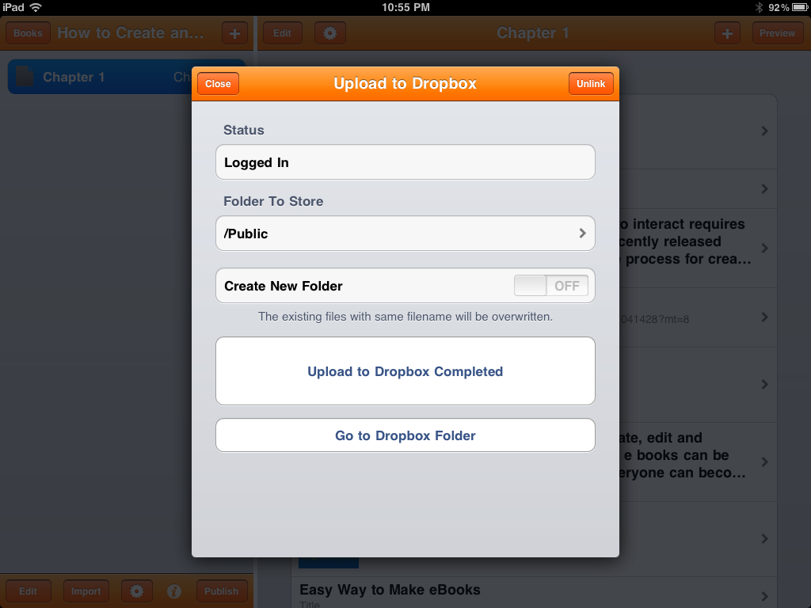
When the upload is completed a new window prompt will appear with an option to view the public folder where the eBook is stored. The public folder is a shared folder allowing other users to have access to the eBook document.
Select Go to Dropbox Folder
To view the eBook in Dropbox select the “Go to Dropbox Folder” function.
Notes:
When the upload is completed a new window prompt will appear with an option to view the public folder where the eBook is stored. The public folder is a shared folder allowing other users to have access to the eBook document. To view the eBook in Dropbox select the “Go to Dropbox Folder” function.

Slide 28
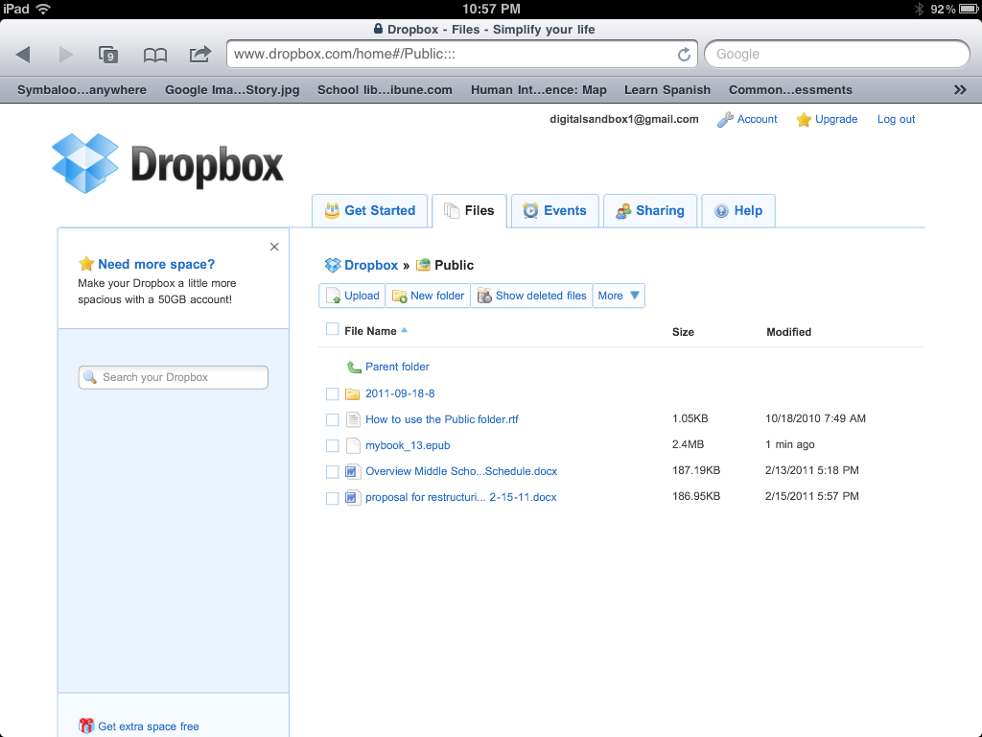
mybook file
Notice in the Dropbox storage folder that a new file exist titled “mybook_13.epub.” To share the eBook you can notify other users by e-mail. To learn more about how to share files watch the video that is hyperlinked to this slide.
Notes:
Notice in the Dropbox storage folder that a new file exist titled “mybook_13.epub.” To share the eBook you can notify other users by e-mail. To learn more about how to share files watch the following video. //www.youtube.com/watch?v=7QmCUDHpNzE&feature=related

Slide 29
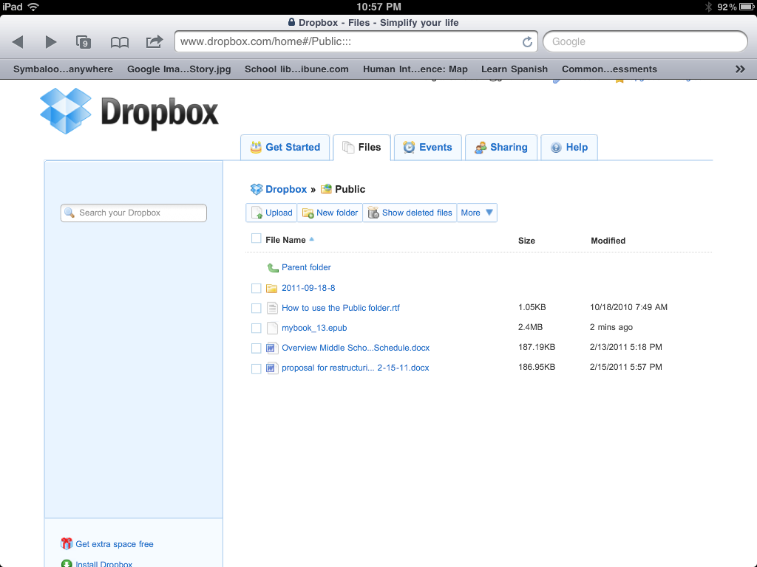

Slide 30
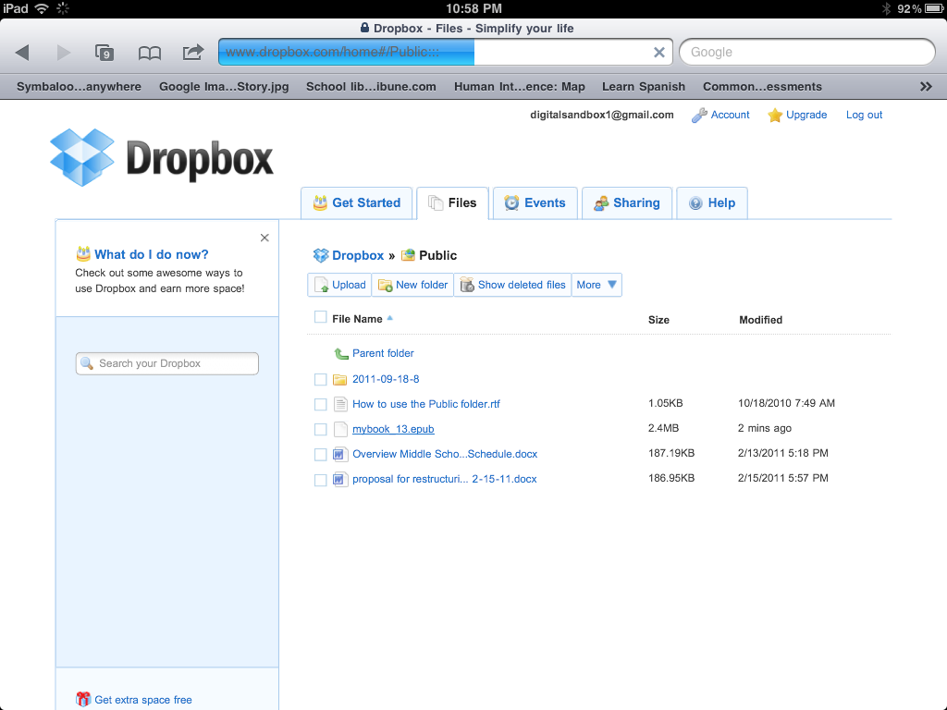
Upload Status Bar
Double Click to Open File
To open the stored eBook file on an iPad, iPod or iPhone double click on the “mybook_13.epub.” The mybook file will begin the upload cycle and will take a few minutes to launch the file. Prior to uploading the eBook make sure that your mobile device has a compatible eBook reader application. A recommended eBook reader for Creative Book Builder is iBooks.
Notes:
To open the stored eBook file on an iPad, iPod or iPhone double click on the “mybook_13.epub.” The mybook file will begin the upload cycle and will take a few minutes to upload. Prior to uploading the eBook make sure that your mobile device has a compatible eBook reader application. A recommended eBook reader for Creative Book Builder is iBooks. http://itunes.apple.com/us/app/ibooks/id364709193?mt=8

Slide 31
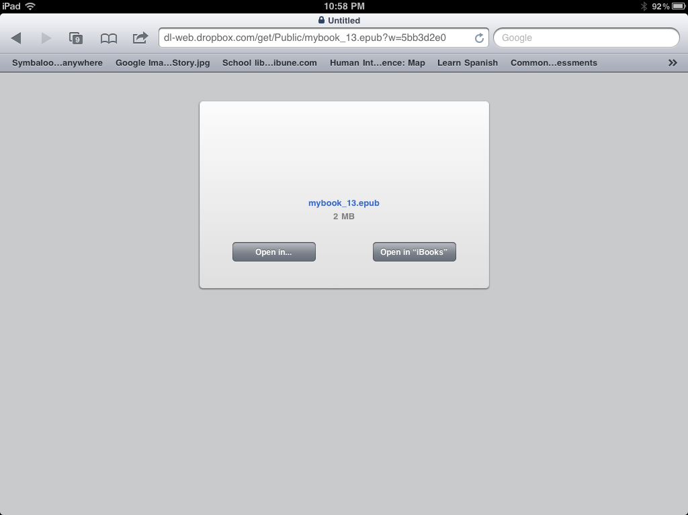
Select Open in iBooks
Once the eBook file has completed the upload cycle a popup menu will appear prompting the user to select the type of application for opening the file. To open the eBook file in iBooks select the “Open in iBooks” function key. The next step in the process will be to demonstrate how to us Dropbox storage as a temporary holding bin for uploading the eBook file to a wiki mobile learning site.
Notes:
Once the eBook file has completed the upload cycle a popup menu will appear prompting the user to select the type of application for opening the file. To open the eBook file in iBooks select the “Open in iBooks” function key. The next step in the process will be to demonstrate how to us Dropbox storage as a temporary holding bin for uploading the eBook file to a wiki mobile learning site.

Slide 32
Creating A Mobile Learning Site
Notes:
Before getting started a pbworks account will need to be established. To learn how to establish a pbworks account watch the video that is hyperlinked the pbworks icon on this slide. http://www.youtube.com/watch?v=u6aB91CaR90

Slide 33
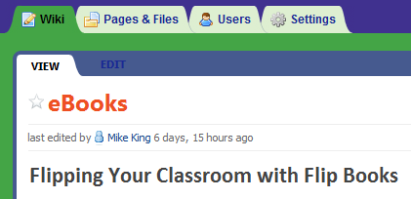
Select Edit Tab
To upload an eBook file to a pbworks mobile learning site select the edit tab in the top left hand corner of the page.
Notes:
To upload an eBook file to a pbworks mobile learning site select the edit tab in the top left hand corner of the page.

Slide 34
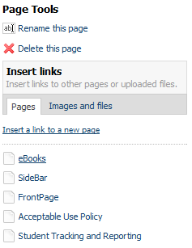
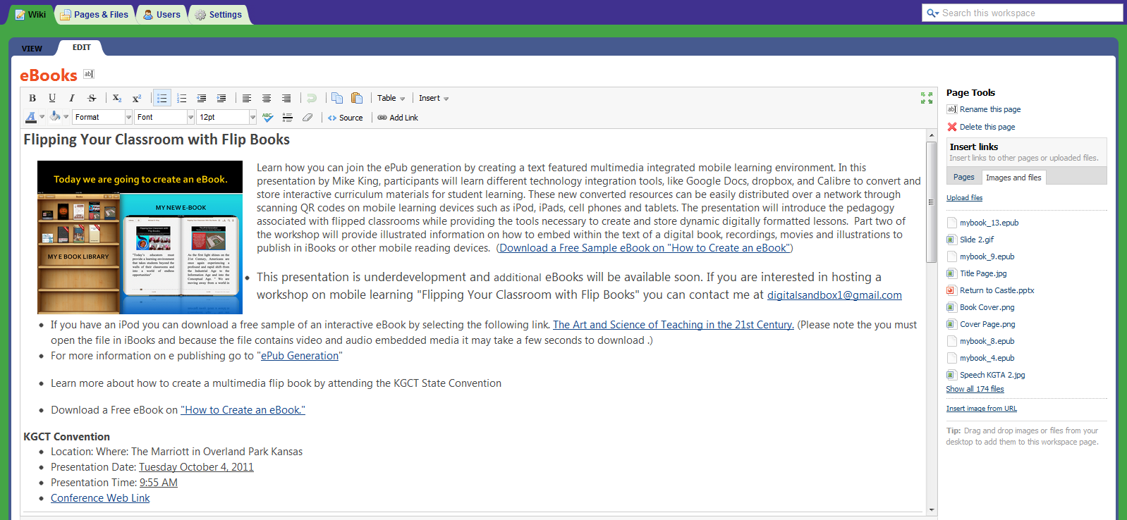
Select Image and Files Link
After selecting the edit tab a window will appear on the top right had side of the side bar. Select the “Images and files” link. This will allow the user to have access to the upload files link.
Notes:
After selecting the edit tab a window will appear on the top right had side of the side bar. Select the Images and files link. This will allow the user to have access to the upload files link.

Slide 35
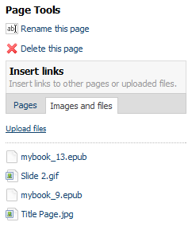
Select Upload Files Link
The next step is to select the Upload files link which will open a popup window allowing the user to select the eBook file from its location.
Notes:
The next step is to select the Upload files link which will open a popup window allowing the user to select the eBook file from its location.

Slide 36
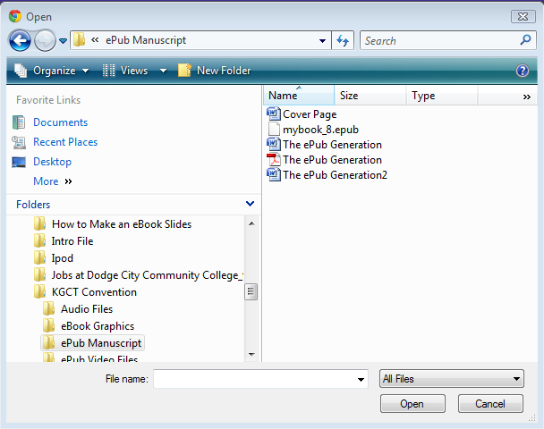
Double Click on Selected File
File Name Appears
Select Open
Mybook_8.ebub
To start the upload cycle Select the file to be uploaded. In this case mybook_8.epub will be selected. To determine the correct file selection the file selected will appear in the file name box. Select open to start the upload.
Notes:
To start the upload cycle Select the file to be uploaded. In this case mybook_8.epub will be selected. To determine the correct file selection the file selected will appear in the file name box. Select open to start the upload.

Slide 37
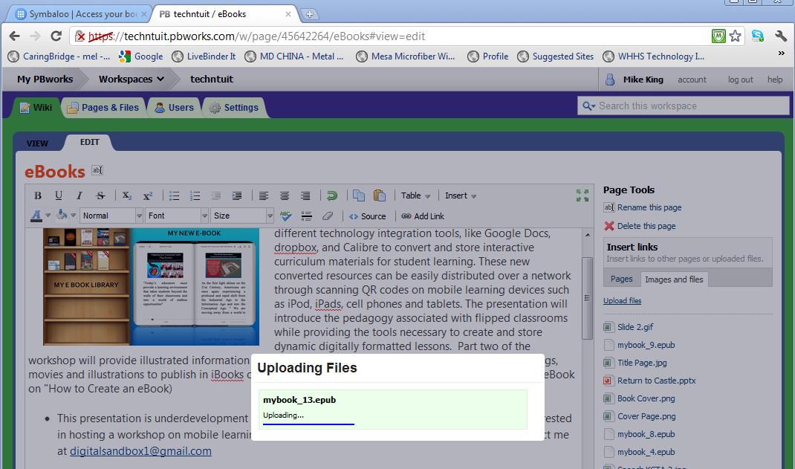
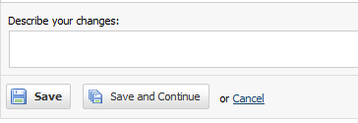
After the file uploads save the save button at the bottom of the wiki page. This will close the edit windows. The next step is to open and copy the link for posting or rendering a QR code.
Select Save
Notes:
After the file uploads save the save button at the bottom of the wiki page. This will close the edit windows. The next step is to open and copy the link for posting or rendering a QR code.

Slide 38
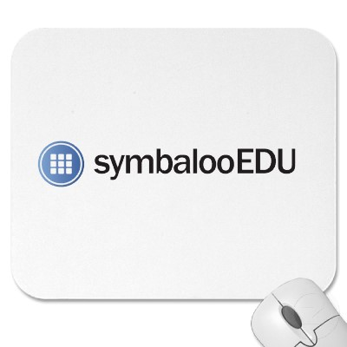
Accessing eBooks for Mobile Learning
Notes:
The eBook file can now be accessed through various interfaces including a QR Code, a sand alone hyperlink, on a shared file in Dropbox, or through a symbaloo dashboard.

Slide 39
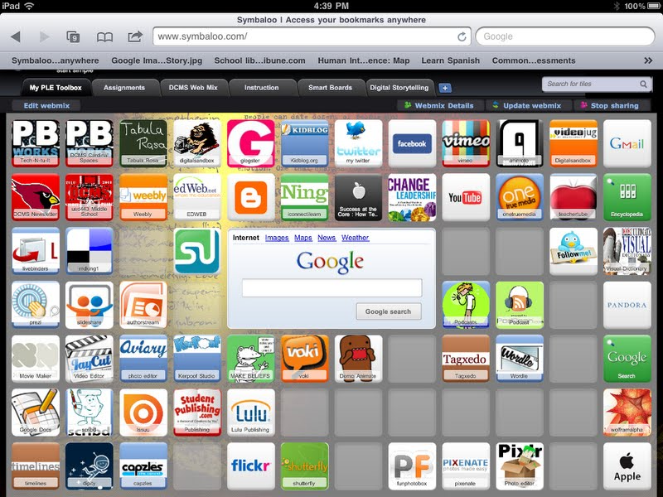
Notes:
The eBook file can now be accessed through various interfaces including a QR Code, a sand alone hyperlink, on a shared file in Dropbox, or through a symbaloo dashboard.

Slide 40
Tricks & Tweaking in Creative Book Builder
When Using Media
Use YouTube downloader
Convert to medium low quality iPhone
Compress mp3 files to medium quality
Create illustrations in PowerPoint and convert to gif file

Slide 41
Tricks & Tweaking in Creative Book Builder
What I Have Learned
When importing files from Google Docs eliminate bullet points within the doc files
Use hyperlinks before using sound or video files
Make books small for short reads and lesson assignments
Plan your content in advance & in small chunks
Preview your book often in the production stages
Email gif files and use save to photo feature in your iPad

Slide 42
Flipping Your Classroom Flip eBooks
with
"Today’s educators must provide a learning environment that takes students beyond the walls of their classrooms and into a world of endless opportunities"
Mike King Presentation
To Schedule an In-service
Contact Mike King
digitalsandbox1@gmail.com
Visit our Website
http://digitalsandbox.weebly.com
Notes:
"Today’s educators must provide a learning environment that takes students beyond the walls of their classrooms and into a world of endless opportunities“ Select flipbook slide to access website resource page for this presentation.

